Slide 1

Matching Employees to Projects
Presenter: Saad Joiya

Slide 2
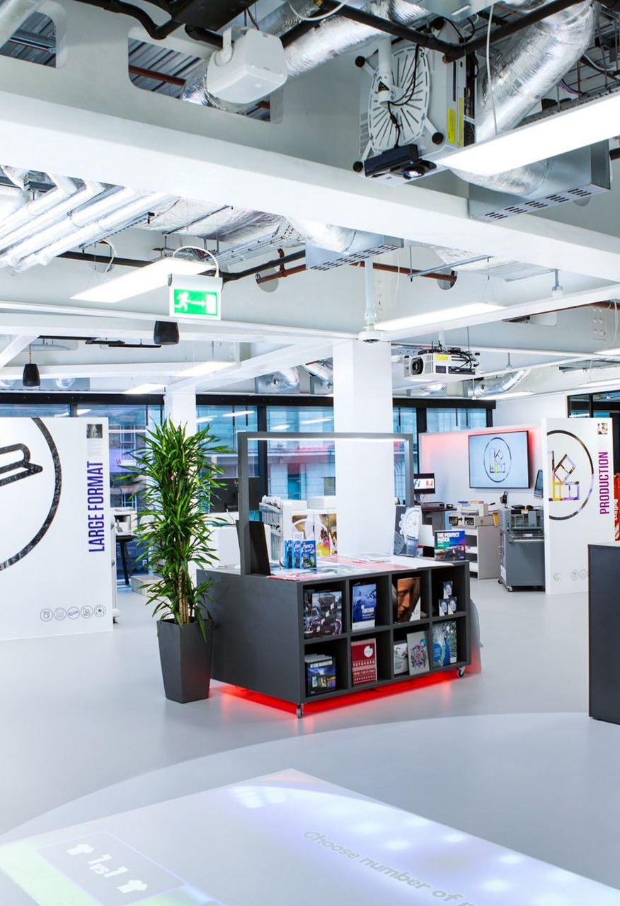
Client Introduction
Partner: Canon – Europe Middle East and Africa
Founded in 1937, Canon provides state-of-the-art imaging solutions to its clients which are spread over a vast array of domains.
Canon develops industry-leading technology supporting future demands of photographers, videographers, office workers, professional printers, medical imaging experts and more.
It has around 150,000 employees across the globe with 15,000 working for Canon EMEA.

Slide 3
Table of contents
01
02
03
04
05
Project Motivation & Aim
Implementation Pre-Requisites
Implementation
Results
Summary & Future Innovations

Slide 4

01
Project Motivation & Aim

Slide 5
Project Motivation
Project Aim
HR of Canon EMEA uses a manual process to match suitable employees for incoming projects. This process is not optimal considering time, effort, scalability and human errors.
A streamlined framework for data collection is also currently absent – employee and project features are being hand filled
For an organization of Canon’s size and stature it becomes imperative to optimally match employees and projects to maximize efficiency and enhance delivery
Create a proof of concept that provides a comprehensive solution streamlining the complete process from data collection to optimal employee allocation.
Enhance Canon’s employee recommender system to provide accurate and consistent recommendations.
Reduce manual work.
Conceptualize a dynamic system that can be matured and refined over time.

Slide 6

02
Implementation Pre-Requisites

Slide 7
Main Pre-Requisites
Data
Score Calculation Algorithm
No access to real world data
Need to define Employee and Project Feature Space
Create mock data for Employees and Projects mimicing real world closely
Find matching features between both tables
Define matching algorithms for each subgroup to generate optimal scores
Define filters and weightages to generate final scores and rank employees

Slide 8
Pre-Requisites and Sources
Pre-Requisite | Source
Employees Data | Mock data creation based on client recommendation
Projects Data | Mock data creation based on client recommendation
Data Fields for both tables | Project Sponsor from Canon
Data Types for all features | Project Sponsor from Canon
Relevant values for features in both tables | Online research of Canon Offerings
Algorithm for matching relevant fields | Online algorithms research
Feedback on match scores | Arena Approach (collaboration with project sponsor)

Slide 9
03
Implementation

Slide 10
Implementation
Mock Data Creation
Define Scoring Algorithms
Interactive Results Dashboard
Create Data for all Employee and Project Features representing all incoming projects and internal talent pool.
Define algorithms to match relevant features to generate scores for different subgroups
Creating an interactive dashboard to display results based on different weightages and filters

Slide 11
Mock Data Creation
Project Features
Project Summary
Text
Scope & Deliverables
Text
Customer Industry
List
Customer Standards
Products Involved
Integration Requirements
Required Skills & Expertise
Complexity Rating
Work Location
Work Flexibility
Language Requirement
Effort Required
Requested End Date
List
List
List
Dictionary
Integer
Category
Category
Language CEFR Level
Dictionary (key)
Dictionary (value)
Integer
Date
Role
Text
Industry Experience
List
Internal / External Certifications
List
Product Experience
Expertise
Core Competency
Core Competency (Expertise)
Work Location
Work Flexibility
Language Known
Available From
Weekly Hourly Availability
List
List
Dictionary (Key)
Dictionary (Value)
Category
Category
Communication Skills
Dictionary (key)
Dictionary (value)
Date
Integer
Cultural Awareness
Integer
Problem Solving
Integer
Leadership
Integer
Employee Features
*Details for these tables in Appendix

Slide 12
Mock Data Creation
Design & Strategy
Realism & Consistency
Human Like Variability
Thematic Control to impose several real-world design constraints
6 high level business themes including HR, Technical, Sales, Marketing, Legal and Consulting with predefined research feature pools
Feature pools created after researching Canon Job postings on official site, LinkedIn and using LLMs.
Ensures internal consistency In features such as products, skills, integrations and certifications.
Mimicking real world data entry errors. Projects Data features such as products, industry, languages can have spelling mistakes
Reliance on fuzzy matching to account for these and create matches
Employee data remains clean (HR System Records)
Leveraging LLM for Text Fields
Text fields such as Project Summary and Employee Role are generated using Google Gemini harnessing prompts based on thematically control features.
Generic Features
Generic pools were created for features such as work location, flexibility, langauages and industries
*Details on themes and pools for features in Appendix

Slide 13




Scoring Algorithm
Project Summary
Text
Fuzzy Match with Threshold
Products Involved
List
Product Experience
List
Vector Embeddings
Same Scoring Logic
0.23
0.67
0.11
Role
Text
Industry Match Score
0.73
0.42
0.51
Hugging face ai
Scope & Deliverables
Text
Cosine Similarity
Coverage Calculation (Project Product list as base)
Job Description Score
Product Match Score
Fuzzy Match with Threshold
Required Skills
Dict
Core Competencies
Dict
Coverage Calculation (Project Integration list as base)
Same Scoring Logic
Integration Requirements
List
Expertise
List
Language Match Score
Expertise Fit Score:
For each overlapping skill: If actual >= required, then 1
Else score = 1 - (required - actual) / 10 Expertise Fit = avg(all skill scores)
Coverage Calculation (Project Skill list as base)
Expertise Match Score
If capability < complexity rating Score = capability / complexity
If capability >= complexity rating
Score = 1
Capability Score
Same Scoring Logic
*Details for these tables in Appendix
Certification Match Score
Skill Match Score

Slide 14
Scoring Algorithm
Availability Score
Employee Available From Date >= Project Requested End Date
Location Match Score
Yes
Employee Bonus Scores
Project Work Flexibility
Score = 0.0
No
Cultural Awareness
Integer
Remote
Hybrid
Onsite
Calculate Calendar Days between Dates
Score = 1.0
Problem Solving
Integer
Employee Location Match
Employee Location Match
No
No
Score = 0.0
Yes
Yes
Score = 0.0
Calculate Working Weeks
Leadership
Integer
EmployeeWork Flexibility
EmployeeWork Flexibility
Remote
Remote
Project Effort / Working Weeks
Onsite
< Employee Weekly Capacity
Required Weekly Effort
Score = 0.0
Hybrid
Hybrid
Score = 0.0
> Employee Weekly Capacity
Score = 0.5
Score = 1.0
Score = 1.0
Score = 1.0
Score = Employee Weekly Capacity / Required Weekly Effort
*Summarized Details for matching criterias in Appendix

Slide 15












Scoring Algorithm
Skill Match Score
Employee 1
Apply Score
Weightages
Employee Weighted Score
Product Match Score
Job Fit Score
Availability
Bucket Filter
User
Project Selected
Final Employee Rank
Employee n
Apply Score Weightages
Employee Weighted Score
Expertise Match Score
User Selects Project
User specified weightages are applied to each score
Algorithm iterates through all employees
All relevant scores are generated
Weighted Scores for each employees are passed through user selected availability criteria
All employees are ranked for the project

Slide 16
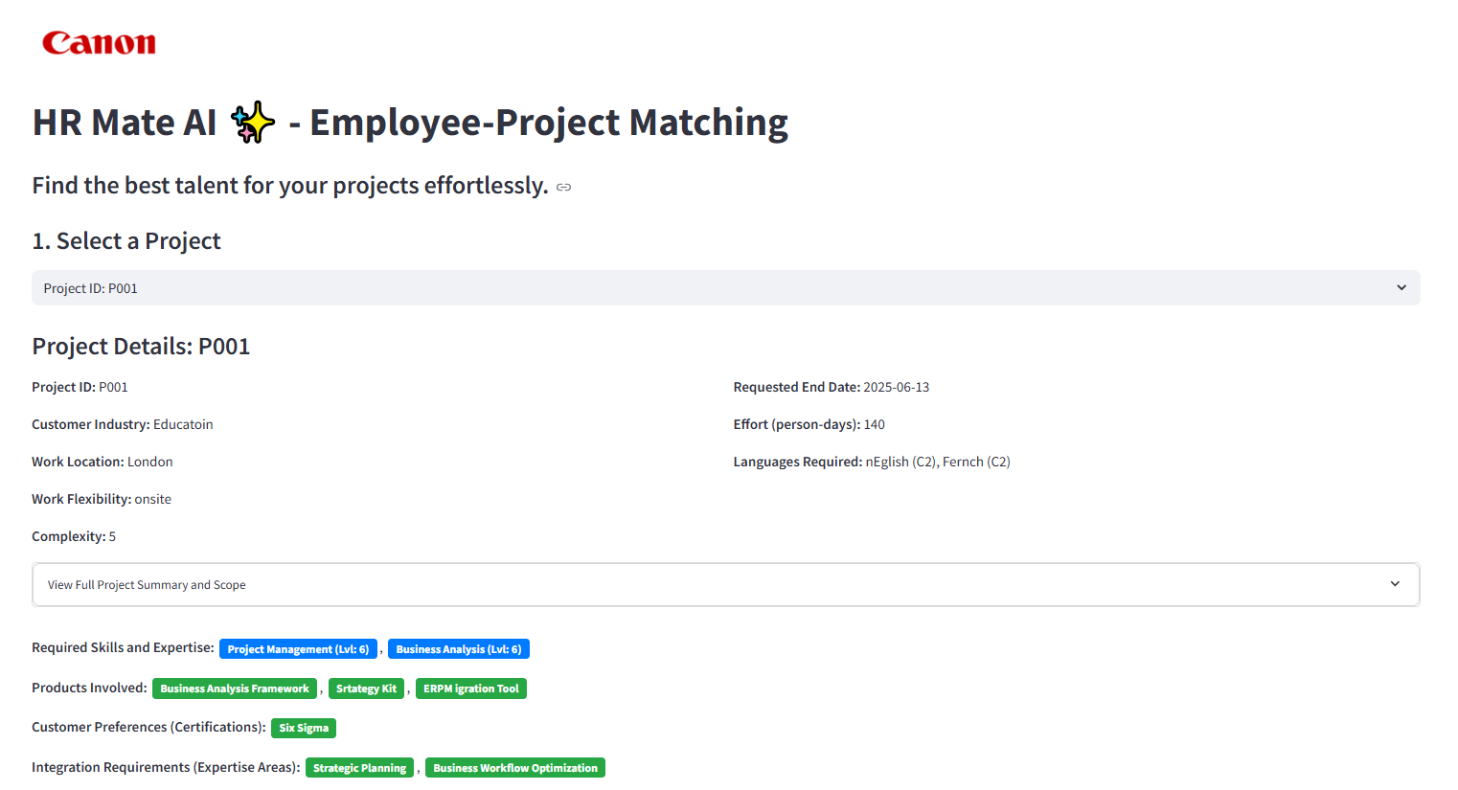
Interactive Dashboard Creation
Created Employees (1000) and Projects (100) mock data based on approach discussed.
Built an interactive dashboard in Streamlit using different helper files for configuring, retrieving, scoring and displaying results interactively.
For selected project, top 50 employees are retrieved based on role fit text (for computational efficiency)
User can interactively adjust weights for different features to generate final scores.
All information for each project and retrieved employees would be displayed including attribute comparison, detailed scores and raw data. This allows user to make sense of the rankings.
This dashboard is deployed on a VM in a docker container for easy access in demo purposes.

Slide 17

04
Results

Slide 18
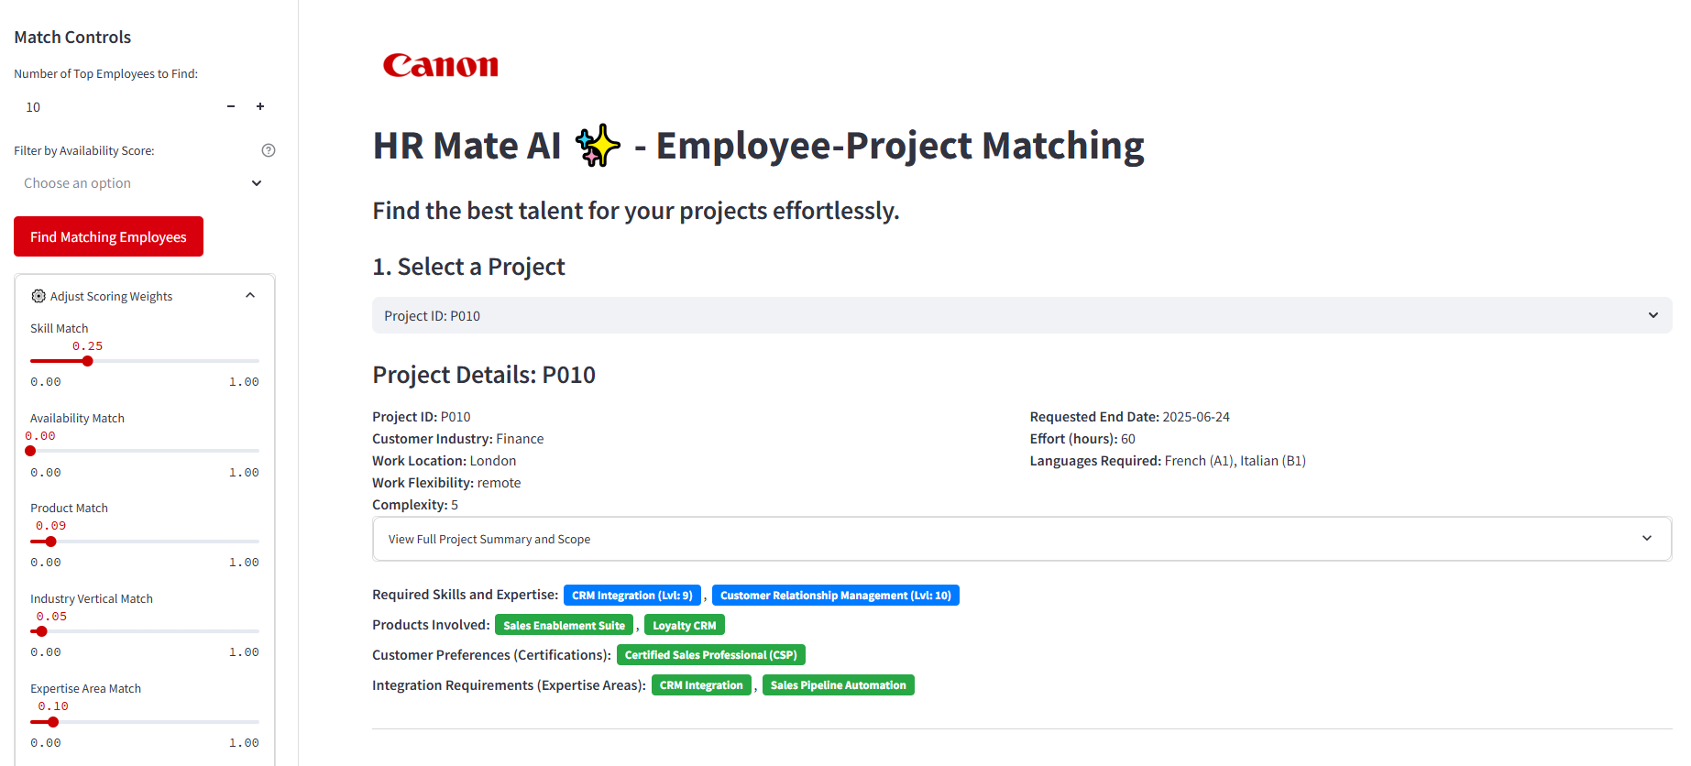
Dashboard

Slide 19
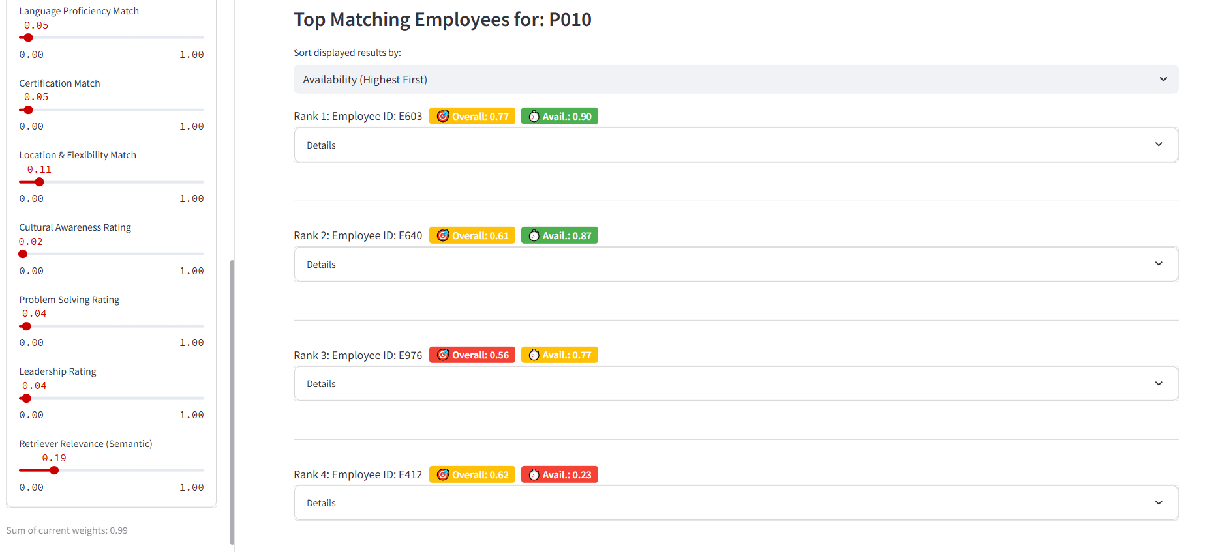
Dashboard

Slide 20
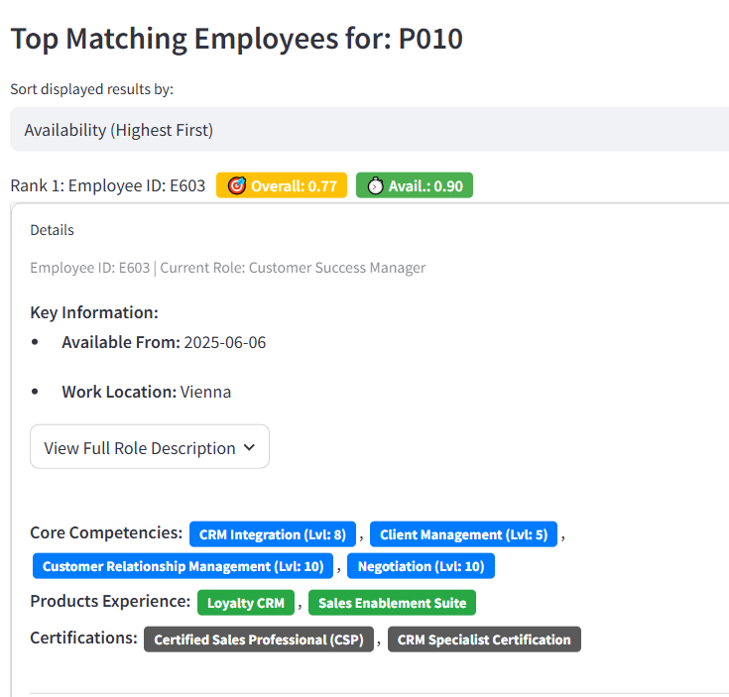
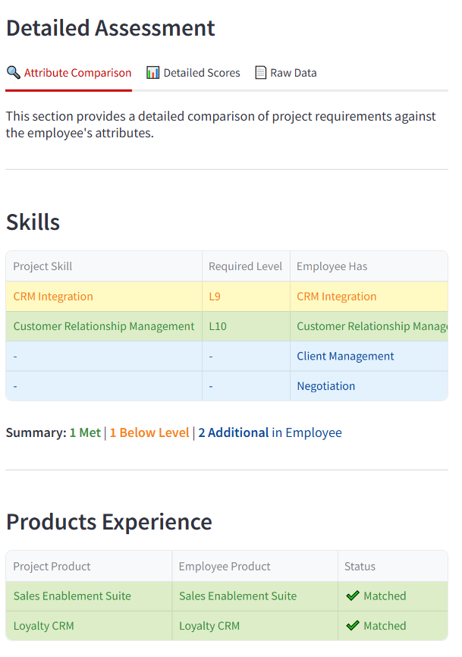
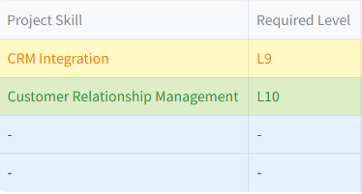
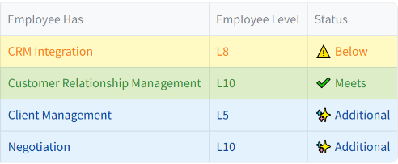


Slide 21
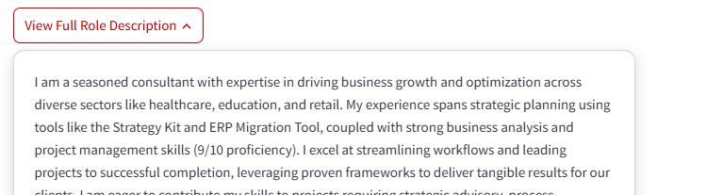
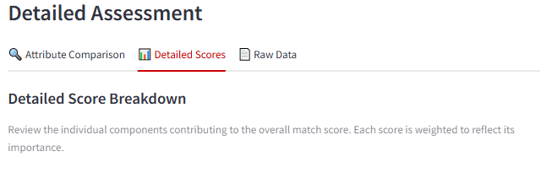
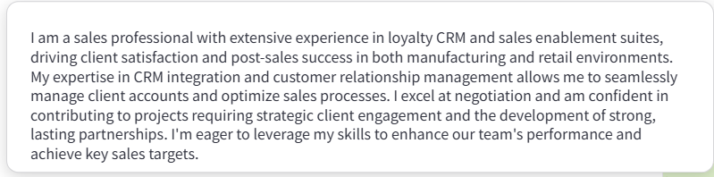
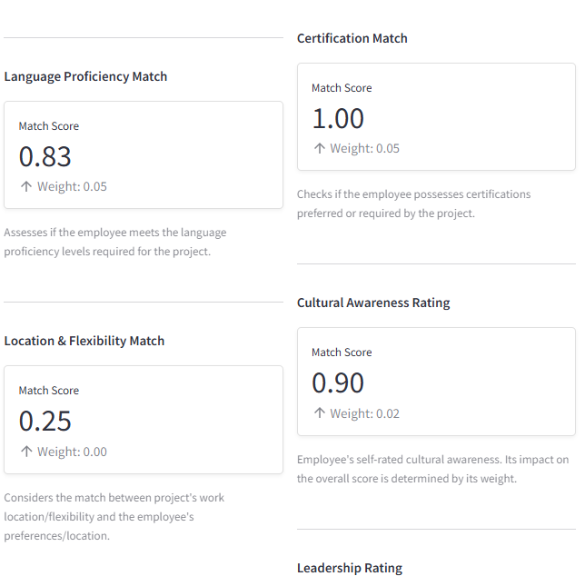
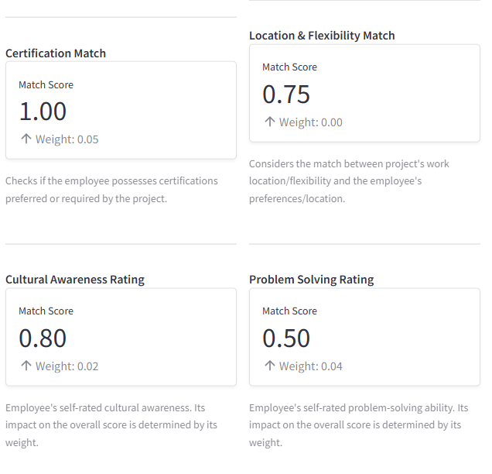
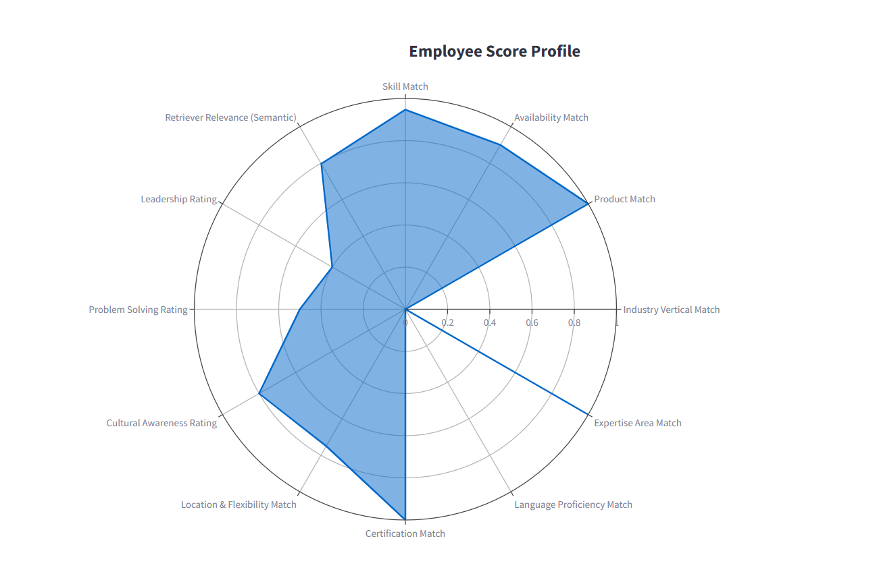
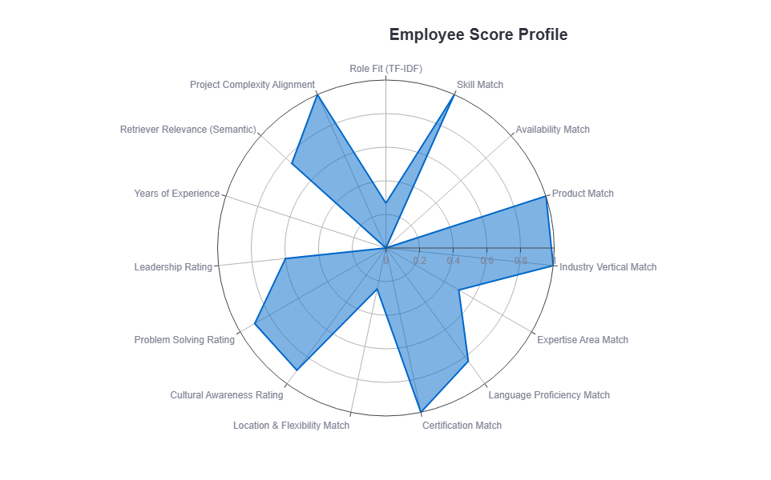

Slide 22

Evaluation
Arena Approach
Client specific implementation
No historic data or benchmark present to evaluate results.
Employed arena approach for validating results – constant collaboration and feedback from the client based on results
Iterations and improvements based on client feedback to mock data as well as scoring algorithm
Achieved complete client satisfaction on final results

Slide 23

05
Summary & Future Innovations

Slide 24
Summary
Streamlining Data Collection
Mock Data
Creation
Feature Matching and Scoring
Collaborated with the client to define the Employee and Project Data Feature Space
Created mock data mimicing real world data collection with client specific feature values
Outlined matching feature sets and developed algorithms to create match scores for all matching subgroups
Working Prototype
Proof of Concept
Implemented the proof of concept in Jupyter with recurring feedback from client on results
Developed a working prototype in Streamlit showcasing all inputs, processes and outputs for employee ranking

Slide 25
Future Innovations
Integrate Into Current System | User Feedback Mechanisms and Model Retraining | More Sophisticated Pool Taxonomies | Enhancing Matching Criterias | Extending to Other Use Cases
Develop APIs or connectors to integrate HR Mate AI with existing Human Resource Management Systems (HRMS) | Get explicit feedback on match quality | The predefined pools that we currently use to generate features can be extended to other themes and feature values | We can define relationships between different feature values used in coverage calculation | Extend the system to not only match employees to current projects but also to suggest projects or training that align with their stated career goals
 | Log and Analyze Matching Performance |  | Standardizing ontologies would result in algorithm being more flexible to human inputs
 |  |  |  | Enhance the system to assist in forming optimal project teams, considering not just individual skills but also team dynamics, complementary skill sets, and diversity
 | Adjust scoring weights for better performance |  | For e.g. "Python" is related to "Data Science"
 | Long term: Move to ML based classification models as data is collected | This brings more sophistication and realism to the process

Slide 26
Thank you!

Slide 27
Project DataFrame
Features | Description | Data Type | Details
Project Summary | Give a summary of the project | Text | Free text, ex. "This project will support the European patent attorney team by building internal systems and support processes aligned with their strategic objectives."
Scope and Deliverables | Outline the scope and list milestones | Text | Free text, ex. "Design support processes, create documentation for best practices, collaborate with business units, and track implementation progress."
Customer Industry | Specify the customer’s industry (e.g., finance, healthcare) | List | Finance, Healthcare, Retail etc
Customer Preferences or Standards | Any specific standards, compliance, or customer communication preferences | Text | Free text or nonfinite list, ex "Needs to be compliant with ABC100 standard" or "XYZ project methodology is a must"
Products Involved | The specific solutions the project centers on, which is crucial if certain employees have experience in those | List | List. For e.g. MVP AI SCAN, WORKFLOW2000, PRINT2.0
Integration Requirements | Any required integrations with existing systems, third-party tools, or APIs | Text | Integration with ERP System, Master data exchange with rest API etc.
Required Skills and Expertise | Skill Requirements for the project e.g., JavaScript, project management, Printing | Dictionary | JavaScript, Python, Project Management, Graphic Designing, and expertise level (1 to 10 expertise level)
Complexity Rating | A subjective rating classifies the project’s complexity | Integer | 1 to 10
Work Location | Location of Work Office | Category | Canon Offices Cities/European City
Work Flexibility | Indicate whether the project can be remote, hybrid, or if it requires on-site work in specific locations | Category | Value from either of onsite, Remote, Hybrid
Language Requirements | Languages required to communicate in this project | Dictionary (key) | Languages like English, German, French, Portuguese etc. (nonfinite list can put everything else in others)
Language Level | CEFR Level of languages required to communicate in this project | Dictionary (value) | A1, A2, B1, B2, C1, C2
Effort | Estimated workload in hours required for the project | Integer | Hours Required
Requested Timeline | Desired End Date | Date | Delivery Date

Slide 28
Employee DataFrame
Features | Description | Data Type | Details
Role | Job Description | Text | For e.g. "Provides high-quality patent services including drafting, filing, and prosecuting patents"
Industry Experience | Specify industries experienced in | List | Finance, Healthcare, Retail etc
Internal /External Certifications | Relevant certifications (e.g., PMP, Six Sigma). | List | For e.g. PMP, Six Sigma certifications etc.
Product Experience | Canon Product Names, redacted | List | List. For e.g. MVP AI SCAN, WORKFLOW2000, PRINT2.0
Expertise | Define expertise of employee | List | For e.g. i.e. Scripting, Integration, Color Reproduction, Cloud & Infrastructure
Core Competencies | Specific skills or technologies, e.g., programming languages, project management methodologies. | Dictionary (key) | For e.g. JavaScript, Python, Project Management, Graphic Designing
Core Competencies (Expertise) | Rating Specific skills or technologies, e.g., programming languages, project management methodologies. | Dictionary (value) | Core Competencies expertise level (1 to 10 expertise level)
Work Location | Location of Work Office | Category | Canon Offices Cities/European City
Work Flexibility | Indicate whether the project can be remote, hybrid, or if it requires on-site work in specific locations | Category | Value from either of Onsite, Remote, Hybrid
Languages Known | Languages required to communicate in this project | Dictionary (key) | Languages like English, German, French, Portuguese etc. (nonfinite list can put everything else in others)
Communication Skills | CEFR Level of languages required to communicate in this project | Dictionary (value) | A1, A2, B1, B2, C1, C2
Cultural Awareness | Openness to diversity and experience in international settings, valuable for global teams. | Integer | Rating 1 to 10
Problem Solving | Critical thinking and adaptability in projects | Integer | Rating 1 to 10
Leadership | Leadership or mentoring/coaching experience. | Integer | Raing 1 to 10

Slide 29
Thematic Controlled Feature Pools
# Controlled Product Pools per Theme
"Technical": ["Workflow2000", "Print2.0", "AIScan", "CloudSuite", "IntegrationHub"],
"Sales": ["CRM Pro", "Sales Enablement Suite", "Loyalty CRM", "SalesForce Light"],
"Marketing": ["Digital Campaign Manager", "SEO Toolkit", "Content CMS", "Social Media Manager"],
"HR": ["HRIS Plus", "Onboarding Suite", "Employee Experience Platform"],
"Legal": ["Compliance Suite", "Contract Manager Pro", "Regulatory Tracker"],
"Consulting": ["ERP Migration Tool", "Business Analysis Framework", "Strategy Kit"]
# Controlled Skill Pools per Theme
"Technical": ["Data Analysis", "Workflow Automation", "Cloud Services", "IT Infrastructure", "API Development"],
"Sales": ["CRM Integration", "Negotiation", "Client Management", "Customer Relationship Management"],
"Marketing": ["SEO Optimization", "Content Strategy", "Campaign Management", "Copywriting", "Branding"],
"HR": ["Digital HR", "Organizational Development", "Talent Management", "Communication Skills"],
"Legal": ["Contract Management", "Regulatory Knowledge", "Document Review", "Compliance Documentation"],
"Consulting": ["Business Analysis", "Strategic Planning", "Workflow Optimization", "Project Management", "Change Management"]
# Controlled Certifications Pool per Theme
"Technical": ["ITIL", "ISO 27001", "Microsoft Azure Certification"],
"Sales": ["Certified Sales Professional (CSP)", "CRM Specialist Certification"],
"Marketing": ["Digital Marketing Certification", "Google Ads Certification", "HubSpot Marketing Certification"],
"HR": ["PMP", "SHRM-CP", "HR Analytics Certification"],
"Legal": ["Certified Compliance Officer", "GDPR Certification", "Contract Law Certification"],
"Consulting": ["PMP", "Six Sigma", "Agile Practitioner", "Business Analysis Certification"]
}

Slide 30
Thematic Controlled Feature Pools
# Controlled Expertise Areas Pool per Theme
"Technical": ["Scripting", "API Integration", "Cloud Infrastructure", "Networking", "Cybersecurity"],
"Sales": ["CRM Integration", "Sales Pipeline Automation", "Client Relationship Systems"],
"Marketing": ["SEO Optimization", "Content Management Systems", "Social Media Integration"],
"HR": ["HRIS Systems", "Employee Experience Platforms", "Organizational Development Systems"],
"Legal": ["Document Archiving", "Contract Management Systems", "Regulatory Compliance Tools"],
"Consulting": ["Strategic Planning", "Business Workflow Optimization", "ERP Systems Integration"]
# Predefined vocabularies
locations_master = ["Berlin", "Vienna", "London"]
work_flexibility_options = ["onsite", "remote", "hybrid"]
languages_master = ["English", "French", "German", "Italian"]
fluency_levels = ["A1", "A2", "B1", "B2", "C1", "C2"]
industries_master = ["Healthcare", "Education", "Finance", "Manufacturing", "Retail"]

Slide 31
Matching Criteria
Project Feature | Employee Feature | Matching Method | Notes
Project Summary | Role | Text Embedding / Cosine Similarity | General fit & thematic similarity based on text embeddings and cosine similarity
Scope and Deliverables | Role | Text Embedding / Cosine Similarity | Task alignment based on text embeddings and cosine similarity
Customer Industry | Industry Experience | Category Similarity (Fuzzy match with threshold) | Match industries for coverage
Customer Preferences or Standards | External Certifications / Internal Certifications | Category Similarity Coverage (Without Fuzzy Match) | Match Certifications for coverage
Products Involved | Product Experience | Category Similarity Coverage (Fuzzy match with threshold) | Matching Products for coverage
Integration Requirements | Expertise | Category Similarity Coverage (Without Fuzzy Match) | Match Integration requirements for coverage
Required Skills and Expertise | Core Competencies | Category Similarity Coverage (Fuzzy match with threshold) | Primary skill matching coverage
Complexity Rating | Core Competencies (expertise level) | Coverage x expertise fit (employee capability score) then compare complexity | Compare Employee Capability based on skills to Complexity
Work Location | Work Location | Category Similarity (Fuzzy match with threshold). Irrelevant if remote | Location coverage
Work flexibility | Work flexibility | Category Similarity (Fuzzy match with threshold) | Remote/Hybrid/On-site scoring factoring for location coverage
Language Requirements | Language Proficiency | Category Similarity Coverage (Fuzzy match with threshold) | Check if required language is present for coverage
Language Level | Communication skills | Coverage x language fit (language capability) | Scoring using match or near-match on required fluency factoring for language coverage
Effort | Weekly Availability in Hours | Filter on availability after scoring | Filter on availability after scoring
Requested End | Available From | Filter on availability after scoring | Filter on availability after scoring
- | Cultural Awareness | Optional Bonus (Normalized Score) | Used as soft bonus
- | Problem Solving | Optional Bonus (Normalized Score) | Used as soft bonus
- | Leadership | Optional Bonus (Normalized Score) | Used as soft bonus

Slide 32
Resources
Canon EMEA website:
https://www.canon-europe.com/
Dashboard Link: http://142.93.238.167:8501/
Github Repo: https://github.com/joiya-saad/Capstone-Project
Google Gemini API: https://ai.google.dev/
Hugging Face: https://huggingface.co/BAAI/bge-large-en-v1.5
Dockers Deployment:
https://docs.streamlit.io/deploy/tutorials/docker

